Slide 1
Zinnia
A (questionable) experiment in DSL design and parallel algorithms for signal processing
Yusuf Bham
Arjun Vedantham
Notes:
Arjun

Slide 2
Outline
Background
Language Design
Evaluation and Future Plans
Notes:
A brief overview of our presentation - we’ll focus on some of the background for our project, aspects of the language design, and then our evaluation and future plans for the language.

Slide 3
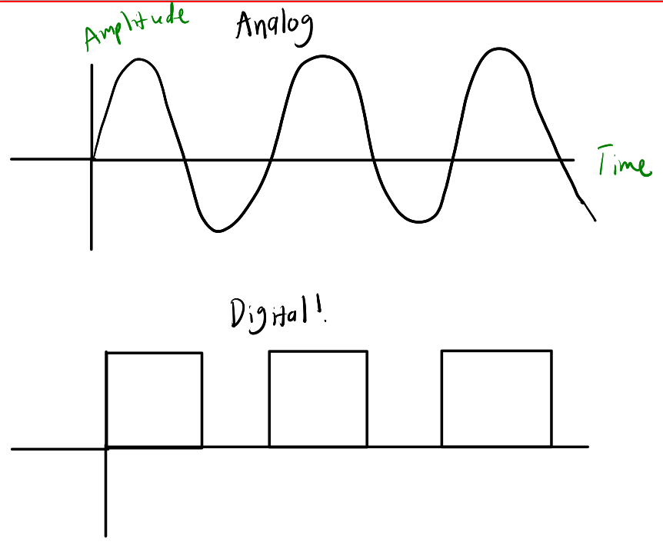
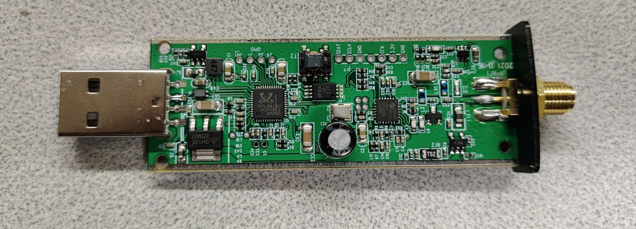
Digital Signal Processing (DSP)
In the past: discrete hardware components
Nowadays: Process digital samples in software
Example: Software defined radio
RTL-SDR
Notes:
Arjun: The setting for our project is digital signal processing. Historically, signal processing was handled through the use of discrete hardware components. Nowadays we want our signal processing systems to be reprogrammable, and it’s much easier to work with digital representations of signals rather than the analog waveforms themselves. One application of this is in software defined radio, which can take radio signals and represent them as a stream of digital values to do processing in software.

Slide 4
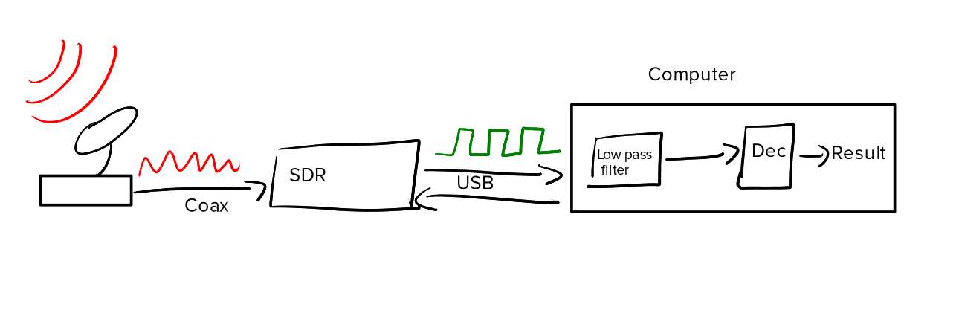
SDR Pipeline
Digital signal processing is great for flexibility and retargetability!
Notes:
Arjun: This is what an SDR setup would look like, as an example of digital signal processing work: we have radio signals received by an SDR’s antenna, converted into digital signals, and then we do things like applying a low pass filter in software over digital values rather than in hardware.

Slide 5
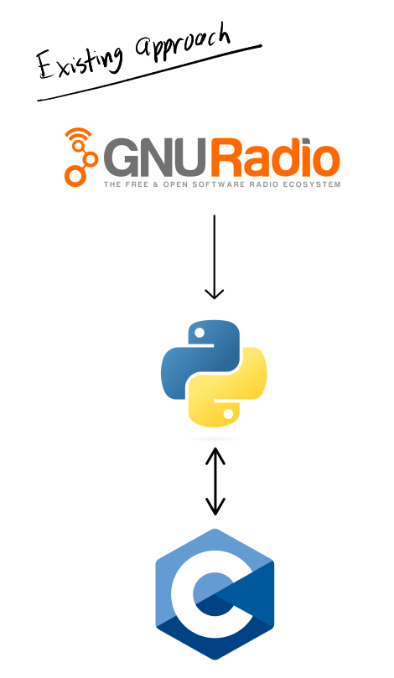
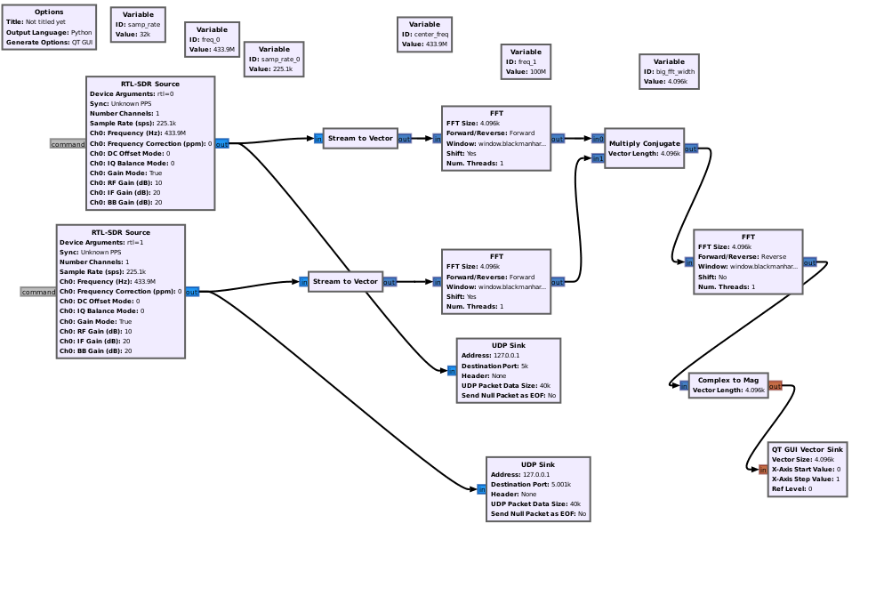
DSP Programming Approaches
Generates long, hard to read Python scripts
CPU-bound!
Notes:
Arjun: Generating code for DSP tasks, especially for software defined radio is not easy. Most of the time, radio engineers are using something like GNURadio, which has a bunch of these pre-built blocks that represent Python modules that are stitched together to generate this flowgraph. There are also bindings into C for specific tasks like demodulating a certain type of signal. The Python scripts generated by GNURadio are horrifically large, and extremely difficult to debug or extend considering all of these opaque C bindings.

Slide 6
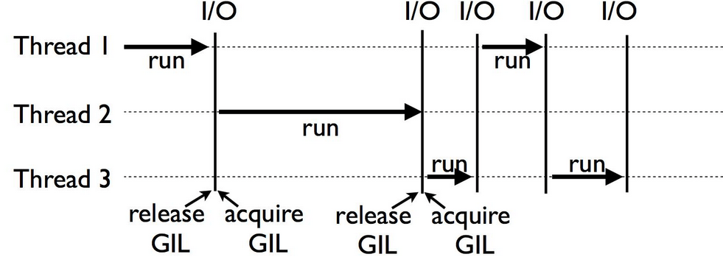
Issues
CPU bound
Python output stunts parallelism
Notes:
Arjun: Python also stunts parallelism on two fronts - one is the implementation of the language (the global interpreter lock), and the other is the fact that we’re executing this code on a Von Neumann machine ultimately. So naturally, using some custom, reconfigurable architecture could be a good way to accelerate performance while maintaining the flexibility of the SDR systems that we know and love.

Slide 7
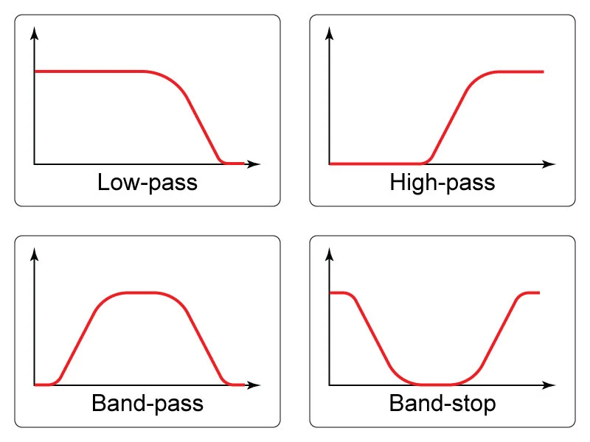
A New Approach?
Hardware acceleration?
FPGAs
Domain specific language?
Better parallelization?
Functional paradigm
Compose filters
Notes:
Arjun: We addressed hardware acceleration and parallelism benefits, but another thing that we liked from taking PL classes is programming in a functional paradigm - considering that a lot of DSP work involves applying filters (like running a signal through a low pass filter to remove high frequency noise, and then isolating a signal at a specific frequency), we thought that would map to functional languages pretty well.

Slide 8
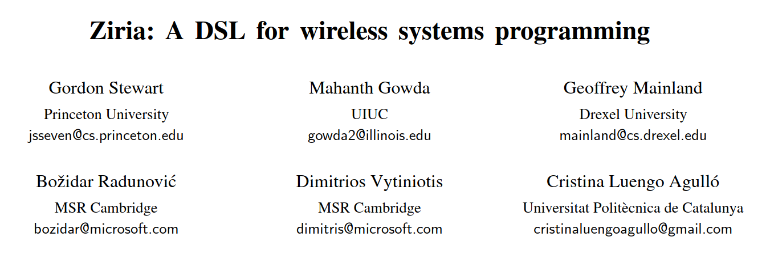
Ziria
Similar premise
Targeted CPUs instead of FPGAs
Aimed at wireless systems programming
Notes:
Y
One example of this that we looked to for inspiration was Ziria, which was a domain specific language for wireless systems programming (specifically implementing the physical layer of wireless protocols). But we wanted a DSL that would be well-suited to any potential signal processing workload, at least for relatively common tasks like filtering, decimation, and maybe some fancier procedures like a Fast Fourier Transform, which can isolate frequencies in a signal.

Slide 9
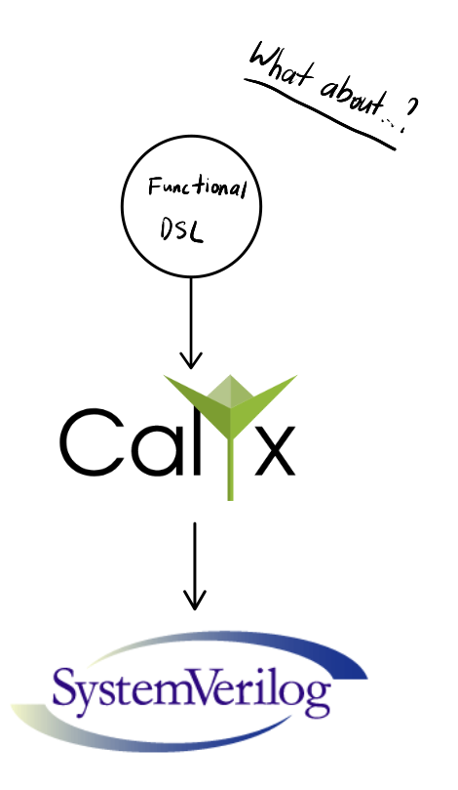
A New Approach?
Notes:
Y
If we want to target hardware, we need a framework that allows us to synthesize hardware efficiently. We don’t want to deal with writing Verilog, so one option that we looked into was using the Calyx intermediate representation, which can generate synthesizable hardware descriptions in SystemVerilog from a relatively high level, akin to how LLVM lowers C into x86 assembly. Calyx is the intermediate representation used by the Filament HDL, which implements timeline types that allow you to reason about latency between different hardware components.

Slide 10
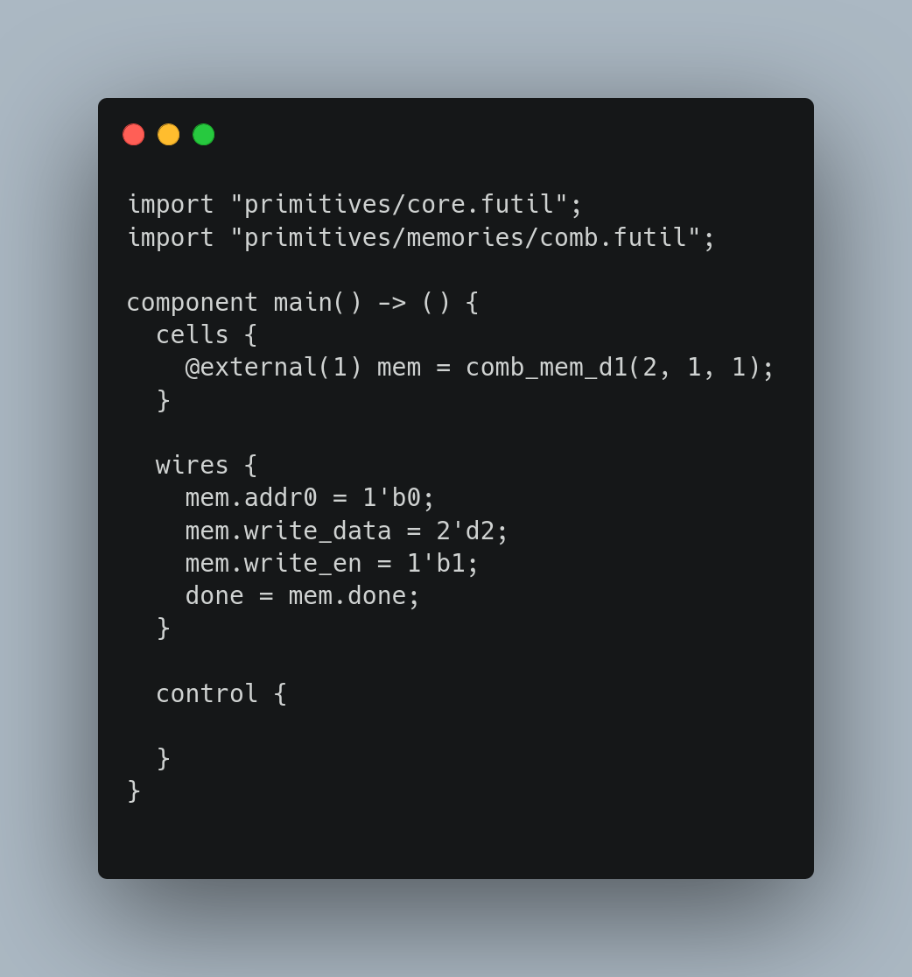
Calyx?
Intermediate representation (IR) for hardware generation
Memory cells
Wires (assignments)
Control schedule
Sample Calyx program
Notes:
Y
Here’s an example of a Calyx IR file - we have a standard library that consists of registers and combinational memories (akin to RAM on a traditional machine). We also have wire groups which represent assignments between ports of different memory cells, and finally we have a control schedule that allows us to specify things like sequential ordering, parallel execution, while/for loops, and if expressions, with some restrictions. In this example, we don’t have any scheduling, so the state of these wires (mem.addr0, write_data, etc.) are held for as long as the circuit is active.

Slide 11
Zinnia
Notes:
Y
So that brings us to our language, which we called Zinnia.

Slide 12
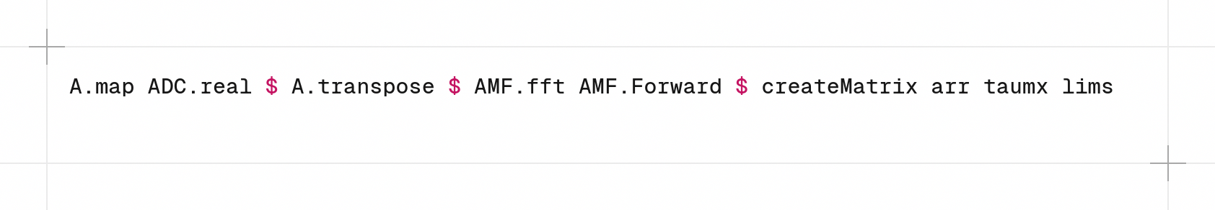
Language Design - Overview
Functional
Easy composition
Modular
Amenable to parallelization
Target: Calyx IR -> synthesizable SystemVerilog
Notes:
Y

Slide 13
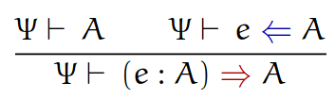
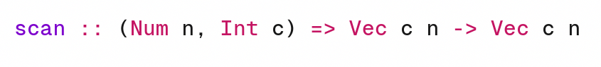
Language Design - Typing
Bidirectional type checker
Inspired by “Complete and Easy Bidirectional Typechecking for Higher-Rank Polymorphism”
Supports high levels of type inference
Support for generics
Notes:
Y
We expose bit width to allow for different ADC resolution

Slide 14
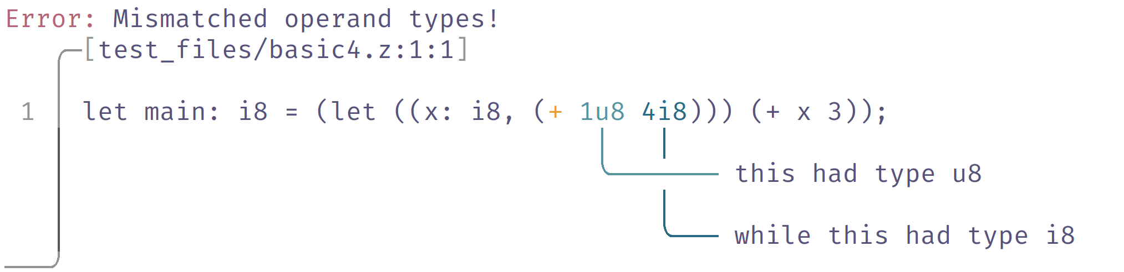
Type Checking
Notes:
Y

Slide 15
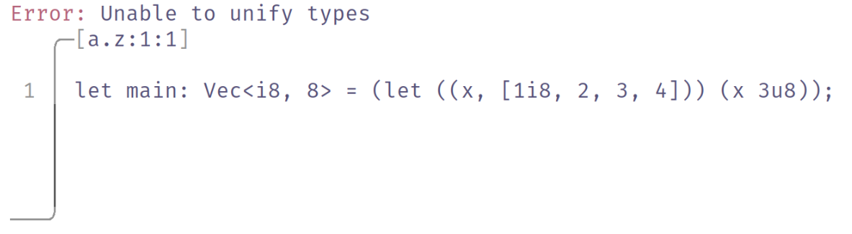
Type Checking

Slide 16
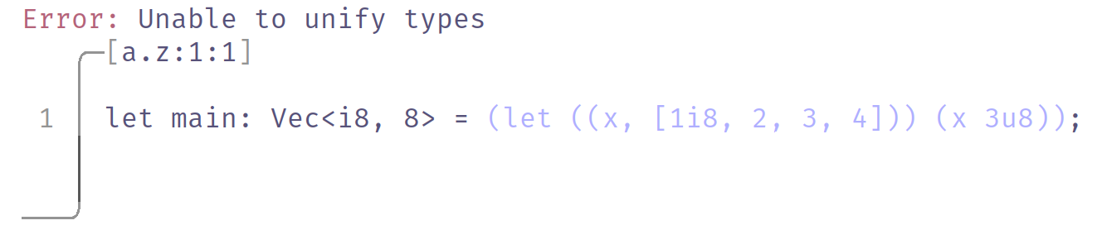
Type Checking

Slide 17
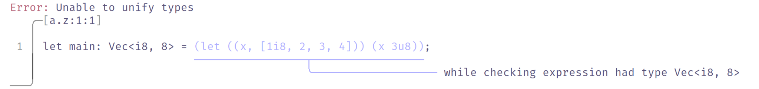
Type Checking
Notes:
Y

Slide 18
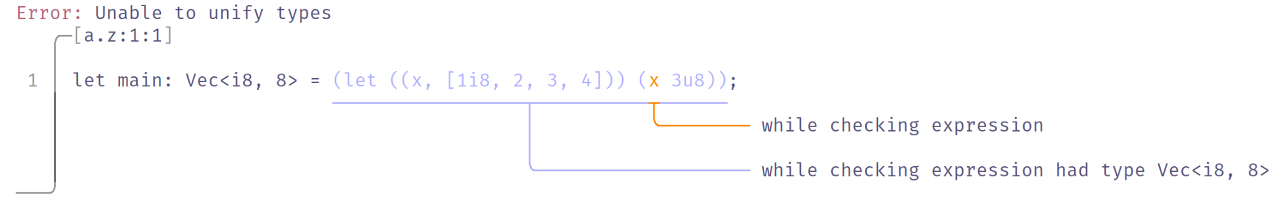
Type Checking
Notes:
Y

Slide 19
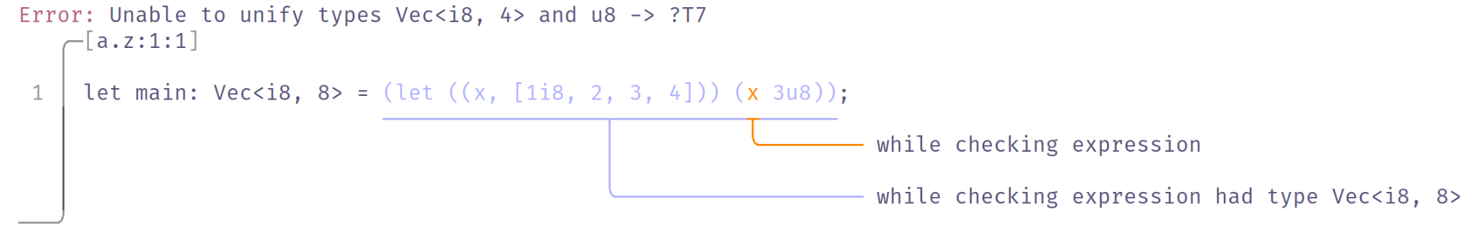
Type Checking
Notes:
Y

Slide 20
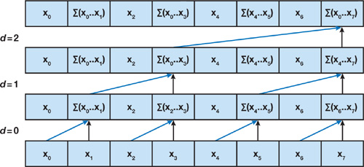
Language Implementation - Scan
Parallel scan/prefix sums
Efficient for user-defined higher order functions
Examples: 1D convolution, rejecting HF samples
Upsweep in parallel scan
Notes:
Arjun: Another feature of our language is a parallelized version of the scan primitive for vectors - this is really useful for things like signal decimation and rejecting high frequency samples in a vector. Right now our scan primitive is somewhat limited - it can only handle vectors of length 8 - but we hope to parameterize this in the future.

Slide 21
Evaluation Plan
Scalability
Correctness
Hardware deployment [reach]
Notes:
Arjun: The evaluation of this project focuses on three key ideas - first is scalability, second is correctness, and the third is hopefully deploying this to hardware, eventually. Here we can see one example of a program from a few slides ago of adding two numbers where the data is loaded into the vector memory that is eventually returned as the “result” of our simulation.

Slide 22
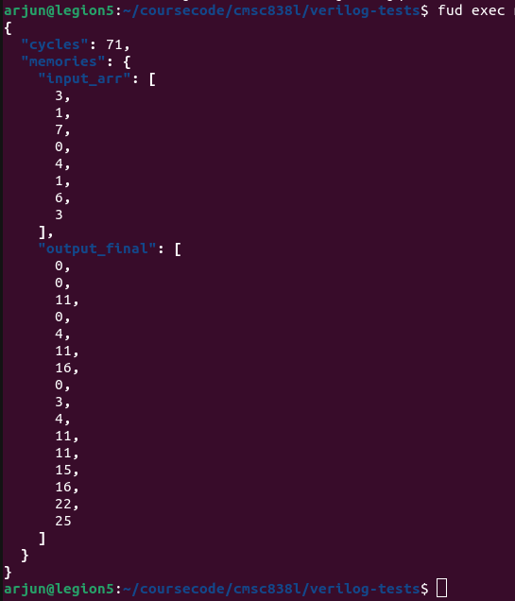
Evaluation - Scalability
Still evaluating
Focus on cycle count in simulation
Show that HLS overhead is minimal
Work should grow with O(n)
Scalability currently limited
Notes:
Arjun: We want to evaluate Zinnia on scalability, primarily by using the cycle count generated by our circuit simulations to show that our synthesis techniques aren’t introducing a large amount of overhead. So for instance parallel scan should be complete in O(n) work, but because of how vector primitives are implemented in the IR, we’re somewhat limited in terms of getting optimal performance.

Slide 23

Evaluation - Correctness
Circuit testing with cocotb
3 clock cycles
70 (?) clock cycles
Adder circuit
“scan” circuit
Load op1
Vector of n elements
Vector of n elements
op1 + op2
Load op2
Notes:
Second is correctness - we started writing a few tests using the cocotb framework to do circuit testing in Python. Cocotb can simulate the circuit and check for correctness conditions at each step of the circuit’s run. So far we’ve only written tests to validate parts of the IR bindings we wrote by hand, but we expect to expand these test scripts to cover more of the circuits synthesized by our language as well.

Slide 24
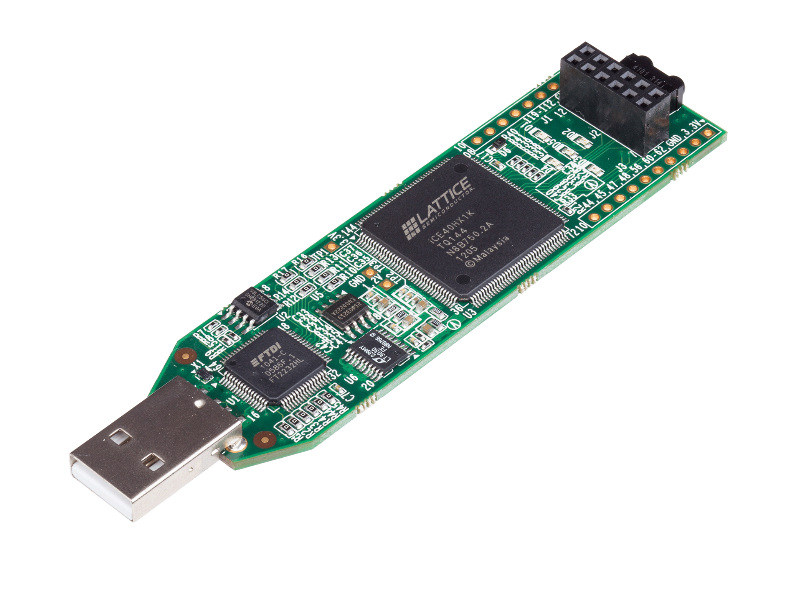
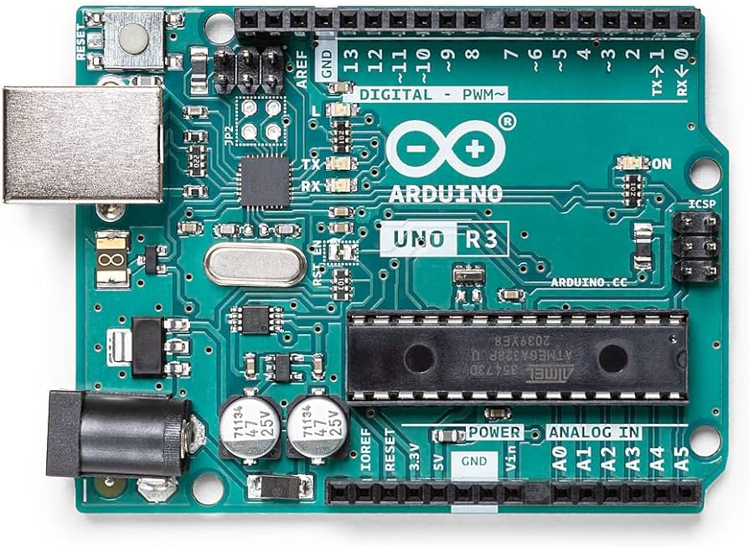
Evaluation - Hardware
Serial
Reprogramming requires a stable clock signal
Notes:
Arjun: Ultimately what we really wanted to show was a Zinnia-synthesized circuit running on an FPGA, specifically this Lattice one. We would have loaded values over a serial connection from something like an Arduino, but turns out that it’s easy to break an FPGA if you’re not careful…and I was not careful.

Slide 25
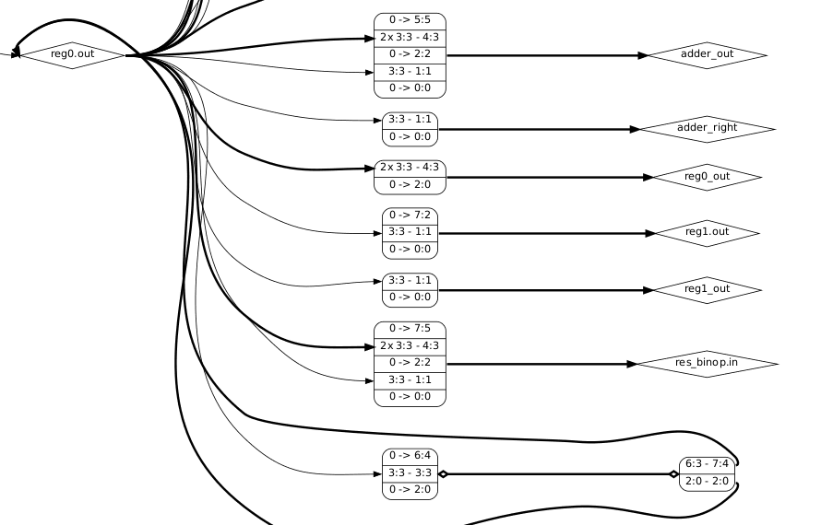
Demo
(Part of) the circuit DAG
Notes:
Here’s a very brief demo of synthesizing and simulating a circuit in Zinnia.

Slide 26
Future Work/Wishlist
Short term
Finish evaluation
Add functions and loops
Long term
Improve scan performance with in-place algorithm
Greater parallelization (memory banking)
Incorporate latency into the control schedule
Linear typing
Reuse vector storage
Dependent types

Slide 27
Summary
Functional, composable language for creating DSP circuits
Implements bidirectional typing features
Provides an easy way to parallelize workloads in hardware
Parallel scan primitive
Notes:
In summary, that has been Zinnia - it’s a functional, composable language for creating DSP circuits. It implements bidirectional typing features, and provides an easy way to parallelize workloads in hardware through a parallel scan primitive.

Slide 28
References
https://developer.nvidia.com/gpugems/gpugems3/part-vi-gpu-computing/chapter-39-parallel-prefix-sum-scan-cuda
https://chandrashek1007.medium.com/python-global-interpreter-lock-is-it-good-or-bad-634d1c82b4fd
https://dl.acm.org/doi/10.1145/2786763.2694368

